Slide 1
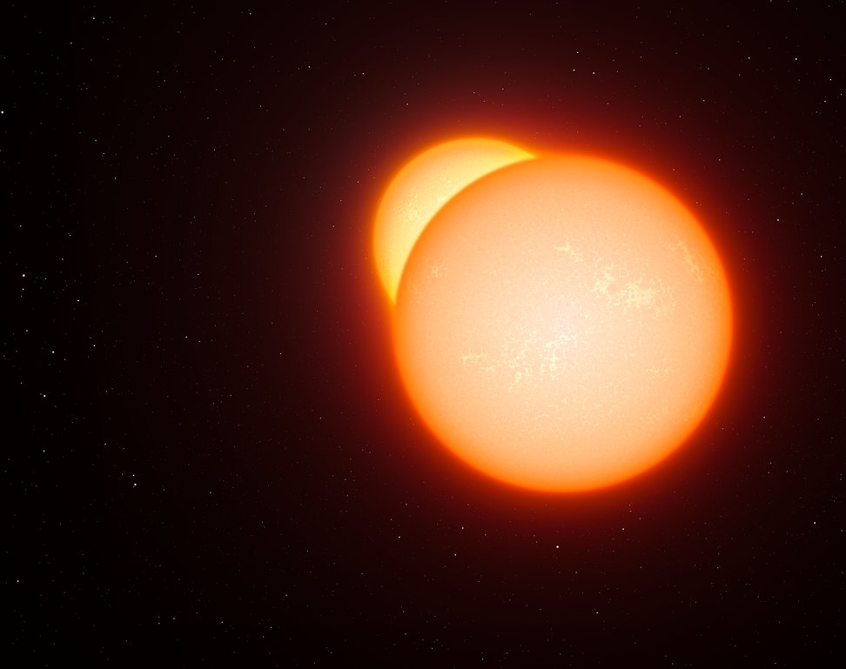
Eclipsing Binary Stars
Das, A., Basant, R., Olson, A.

Slide 2

Introduction & The Science Motivation
Why should we study eclipsing binary stars?
This Photo by Unknown Author is licensed under CC BY

Slide 3
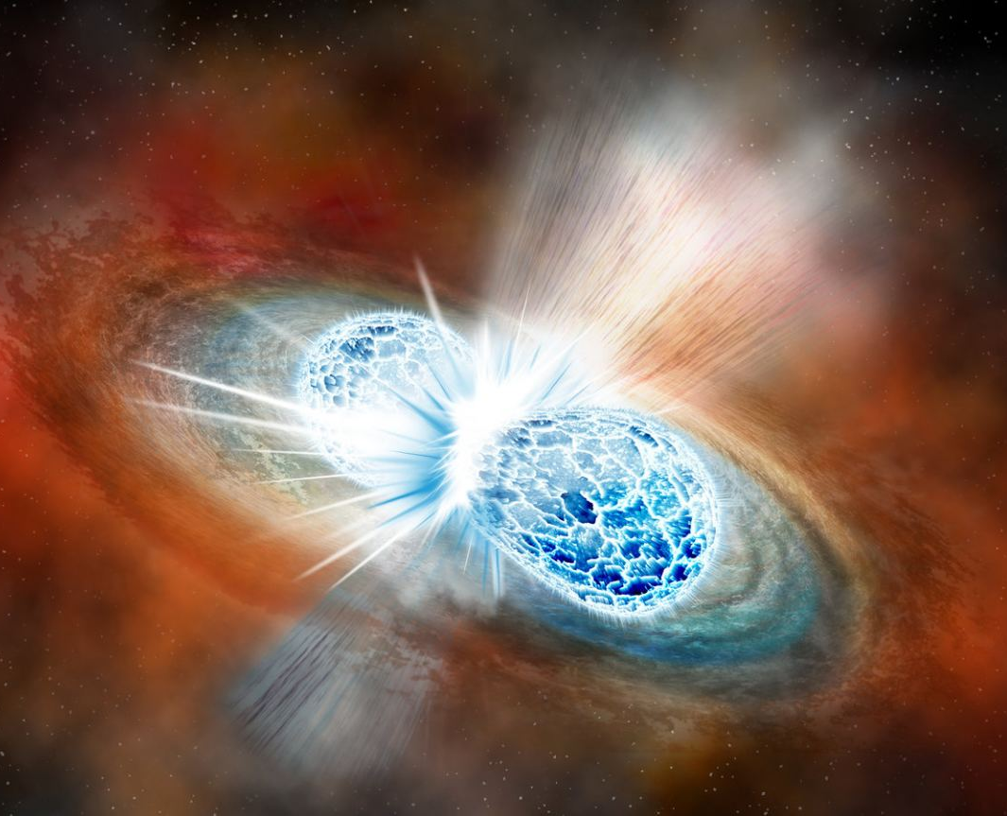
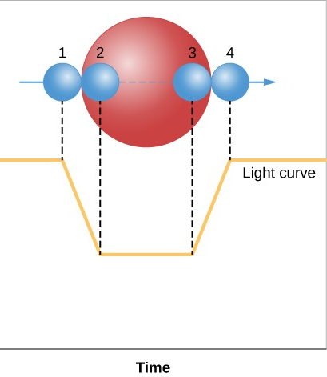
Introduction & The Science Motivation
Eclipsing binaries are integral to study
Stellar Masses
Radii
Luminosities
Ages
Distances

Slide 4
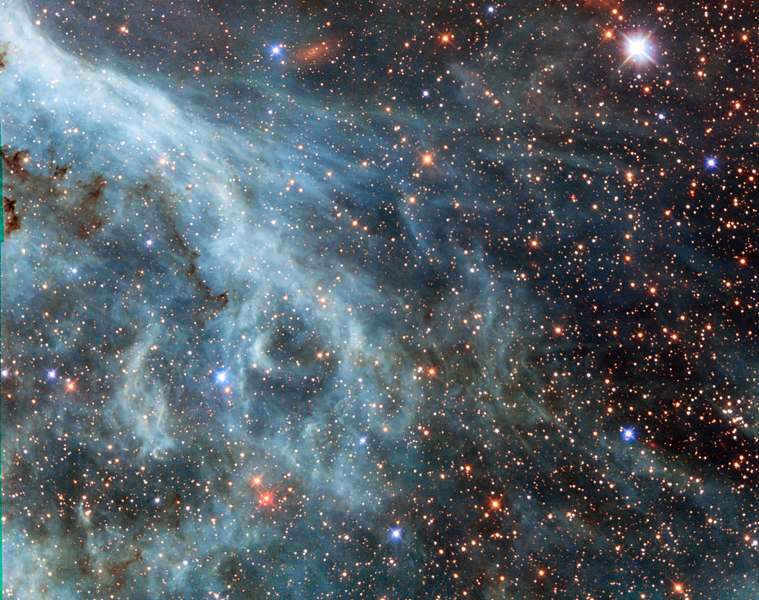
Introduction & The Science Motivation
Used to determine the distances between star clusters in a galaxy and the distances between galaxies.
This Photo by Unknown Author is licensed under CC BY

Slide 5
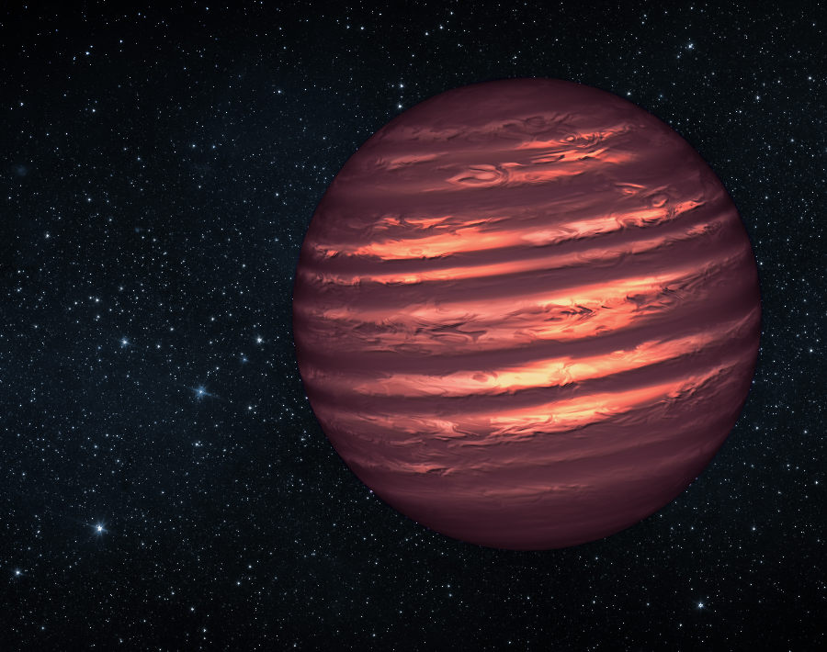
Introduction & The Science Motivation
Determining the physical properties and the evolution of binary members such as
pre-main sequence stars
main sequence stars
giants, super giants
pulsating stars
white dwarfs
black holes

Slide 6
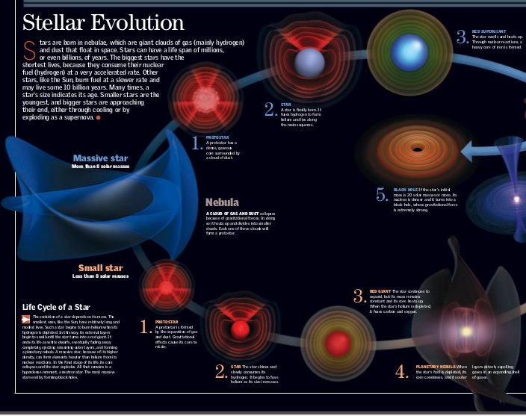
Introduction & The Science Motivation
Could potentially reveal
the star formation rates
dynamics of their host galaxies
possible effects of varying chemical abundance on stellar evolution and structure.
This Photo by Unknown Author is licensed under CC BY-SA

Slide 7

Data Presentation
Identifier: GALEX J19444+5459
V magnitude=15.82
Position:
RA = 19:44:42.9
Dec = +54:49:43
epoch 2000.0
D=1/P ~ 1/0.58582*10^-3 ~ 1.7kpc
Orbital Period (quite short even for these kinds of binaries)
P= 0.0642 days = 1.541 hours
This Photo by Unknown Author is licensed under CC BY-SA

Slide 8
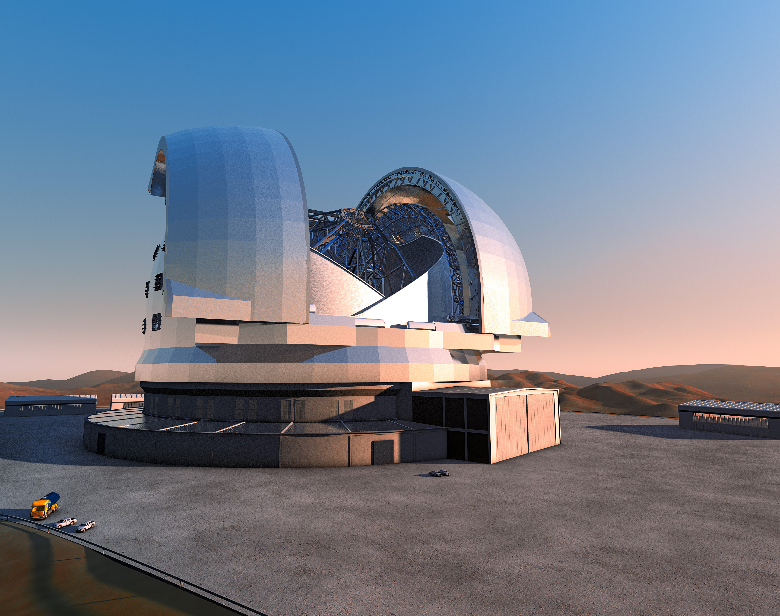
Data Presentation
The data was recorded using the Kuiper 61” telescope for nearly 5 hours
We measured in the V band.
This Photo by Unknown Author is licensed under CC BY

Slide 9
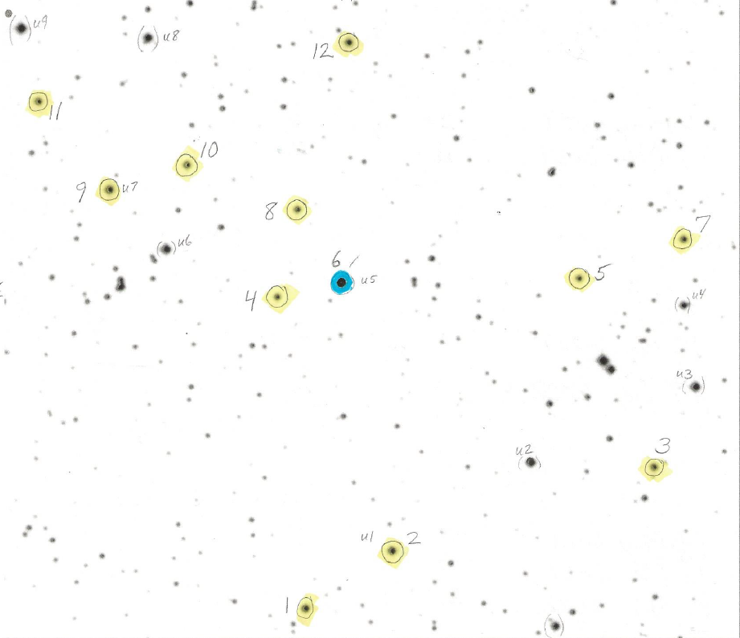
Star Map

Slide 10
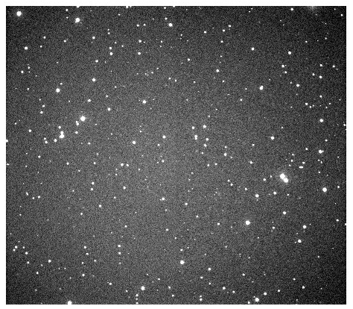
Actual Data

Slide 11
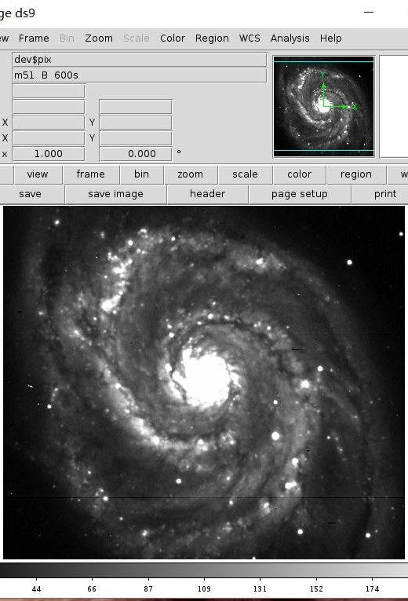
Data Reduction
We used IRAF to correct the collected data for noise and cosmic rays.
Flats, Darks, Biases, and Vignetting.
Once the science images were reduced, we ran photometry and collected the magnitudes of the target star and several reference stars.
This Photo by Unknown Author is licensed under CC BY-SA

Slide 12
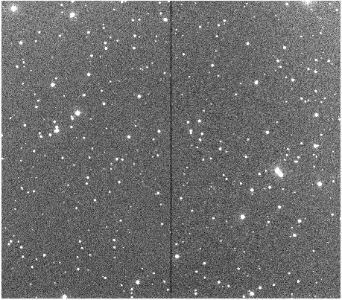
Actual Reduced Science Image

Slide 13
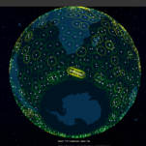
Data Analysis
Running photometry not only gave the instrumental magnitudes, but also the errors in these values.
Note: The photometry only gives the instrumental magnitudes. So, we need to convert them to the apparent magnitudes.
This Photo by Unknown Author is licensed under CC BY-NC-ND

Slide 14
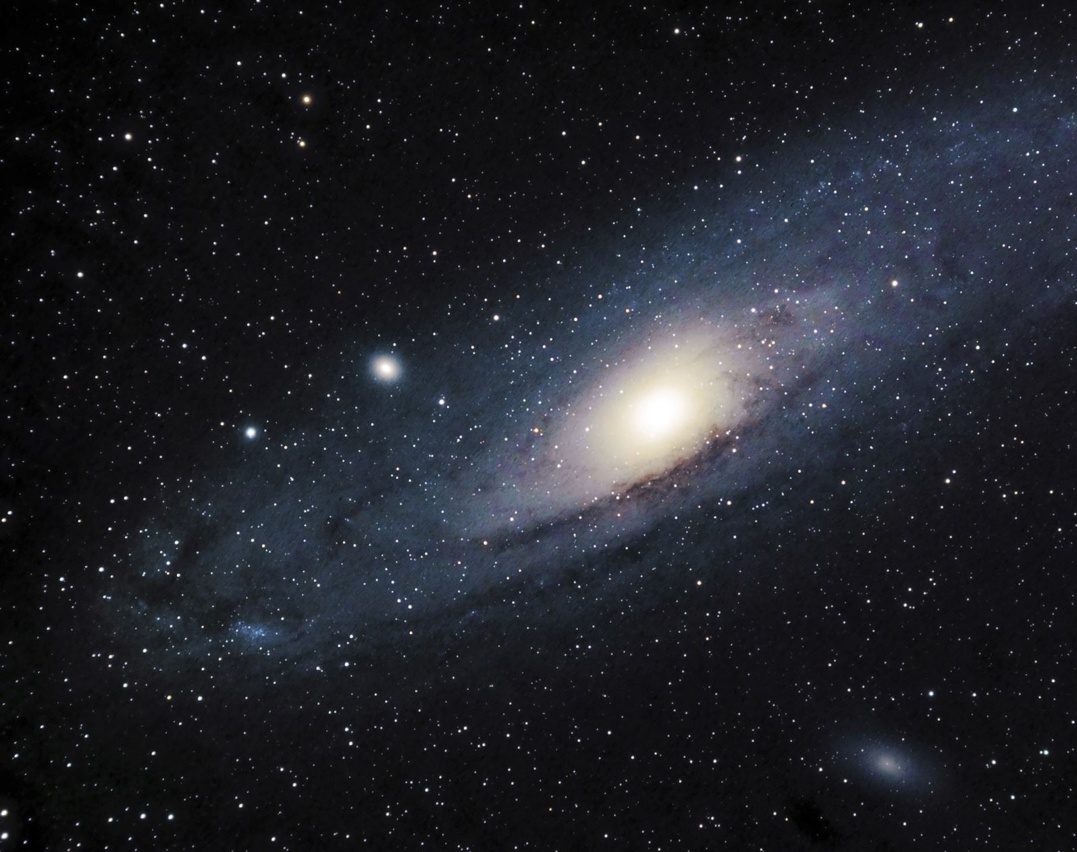
Data Analysis
Once we had the instrumental magnitudes of the target and 4 different reference stars, we used a catalogue to collect the known apparent magnitudes for our reference stars.
Then we compared these values of apparent magnitudes for reference stars with the ones that out telescope recorded.
Using this comparison, we were able to calculate the systematic shift in our telescope, i.e., how far our telescope measures the magnitudes.

Slide 15
Data Analysis
To calculate the systematic shift, we error weighted each data point for 4 reference stars and then calculated the average error weighted shift for each individual image in our reference star.
Using the standard deviation in these 4 error-weighted average shifts and the standard deviation of errors in the instrumental magnitude of the target, we calculated the net error in our measurements.

Slide 16

Data Analysis
Once we had the average of 4 error-weighted shifts, we applied it to the instrumental magnitude of the target.
Using the errors (in previous slide), we also plotted the error bars for each data point of the target's apparent magnitude.

Slide 17

Results

Slide 18
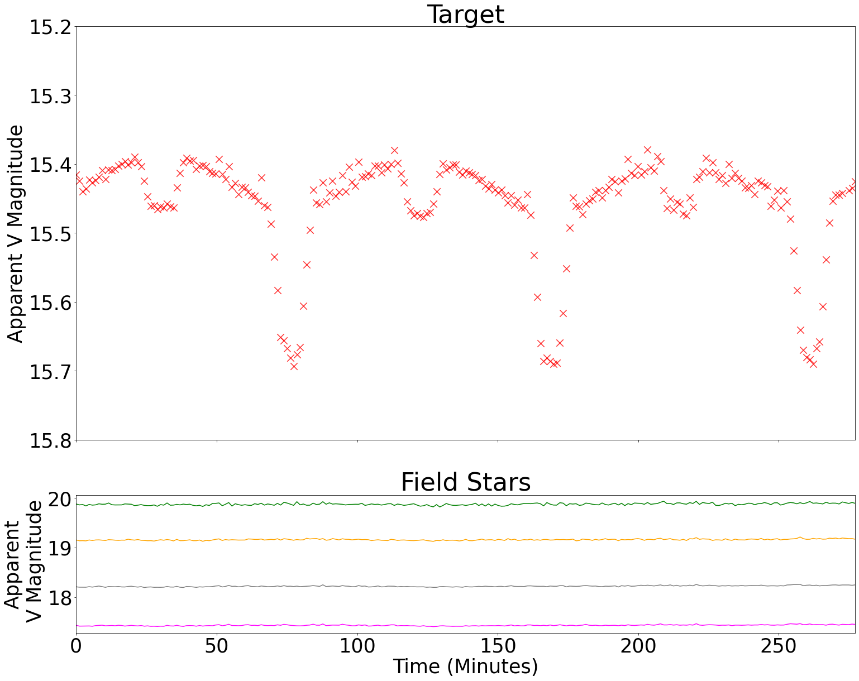

Slide 19
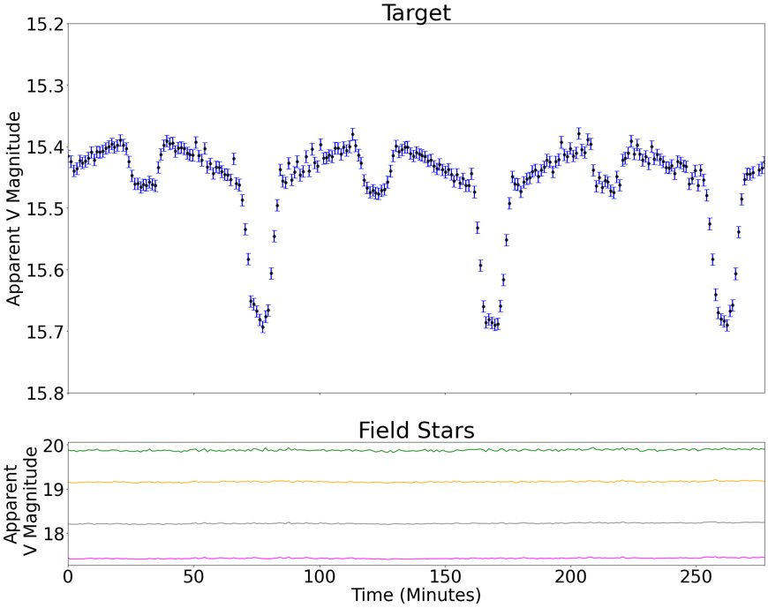

Slide 20
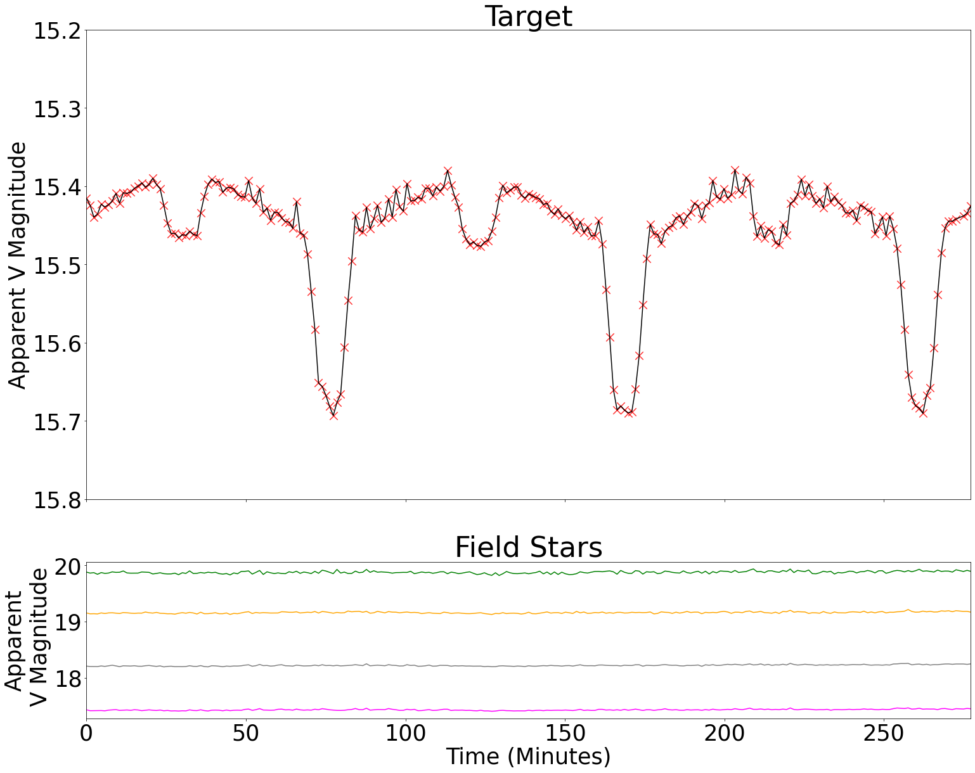

Slide 21
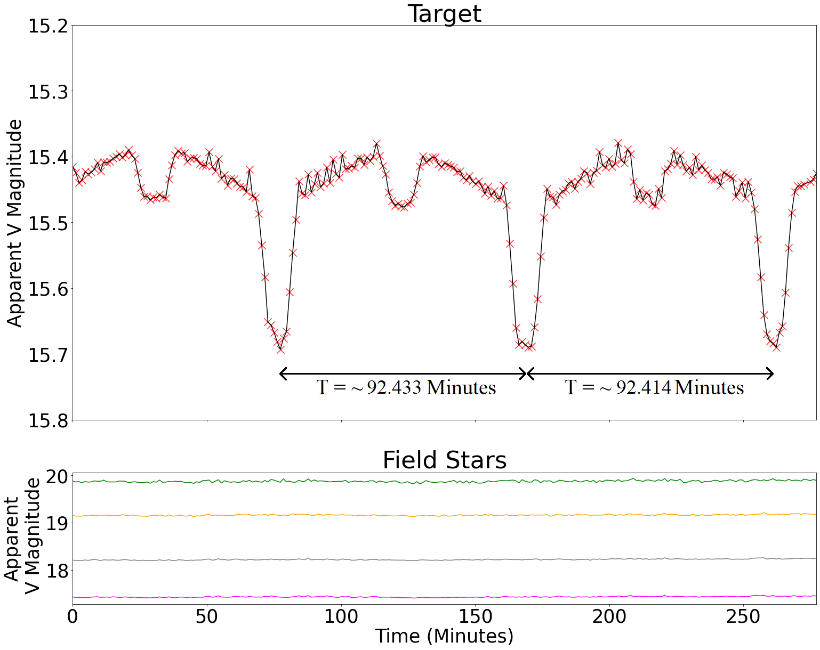

Slide 22
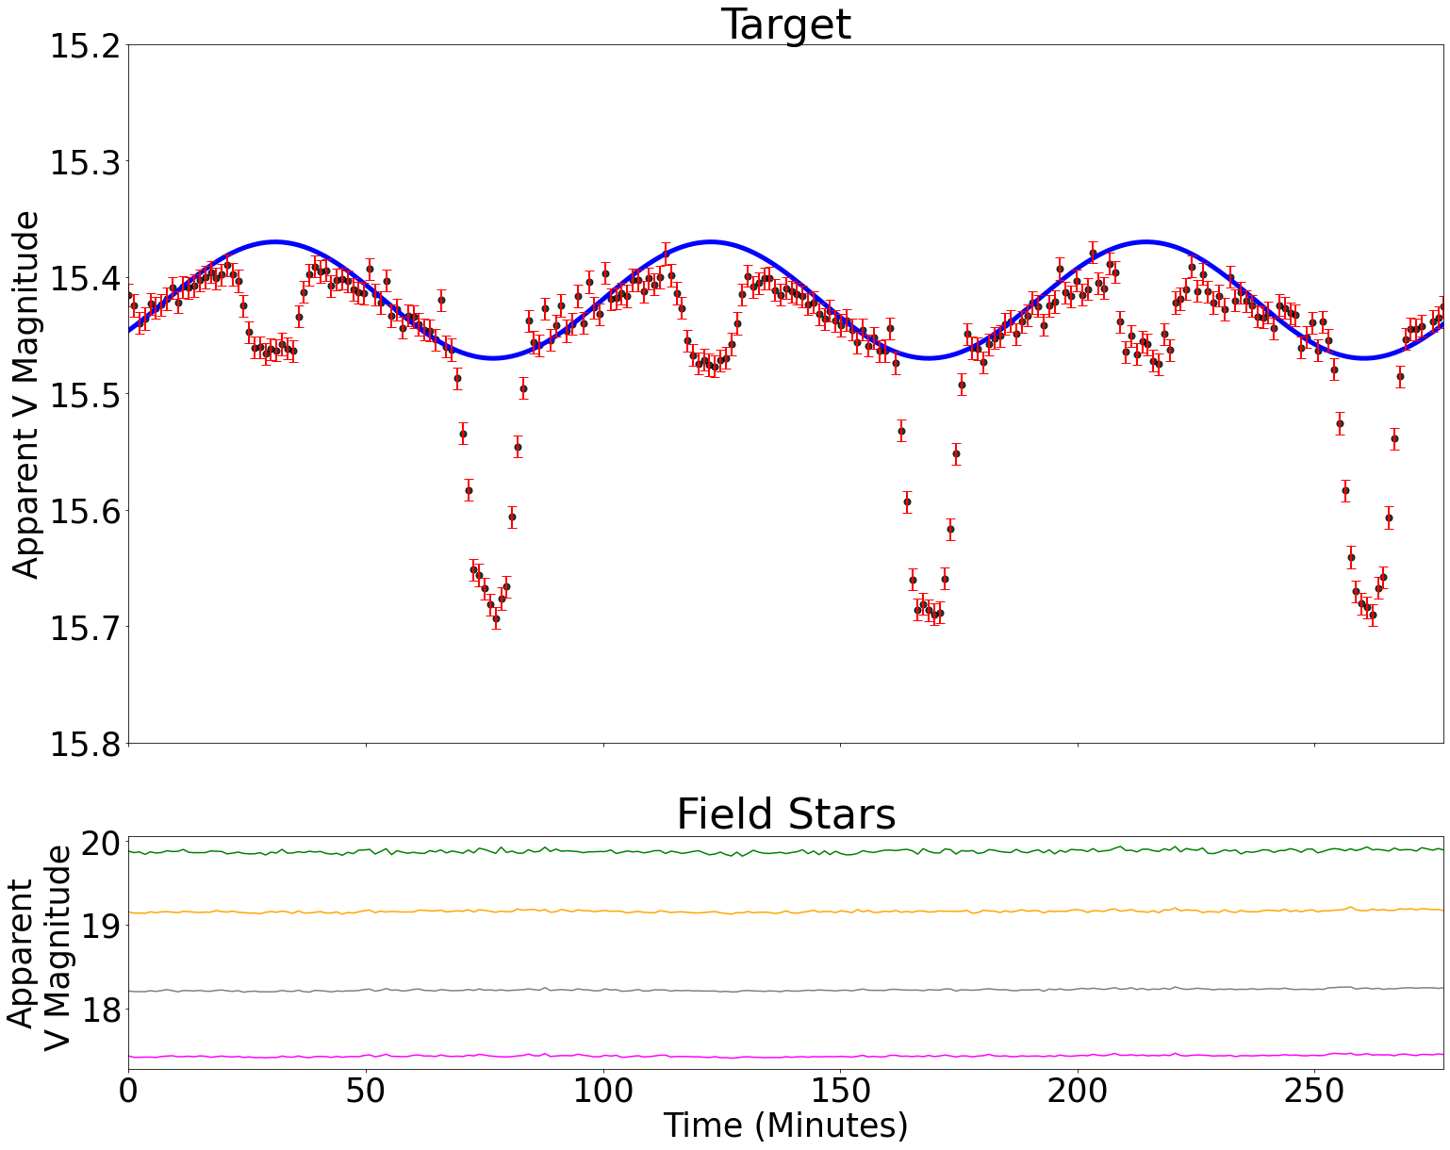

Slide 23
Why Sinusoidal Variation?
Heating effects of the BD!!

Slide 24
What else can we learn?
Probably edge on?
Eccentricity close to zero!
(i) equally spaced dips.
(ii) sinusoidal variation.

Slide 25
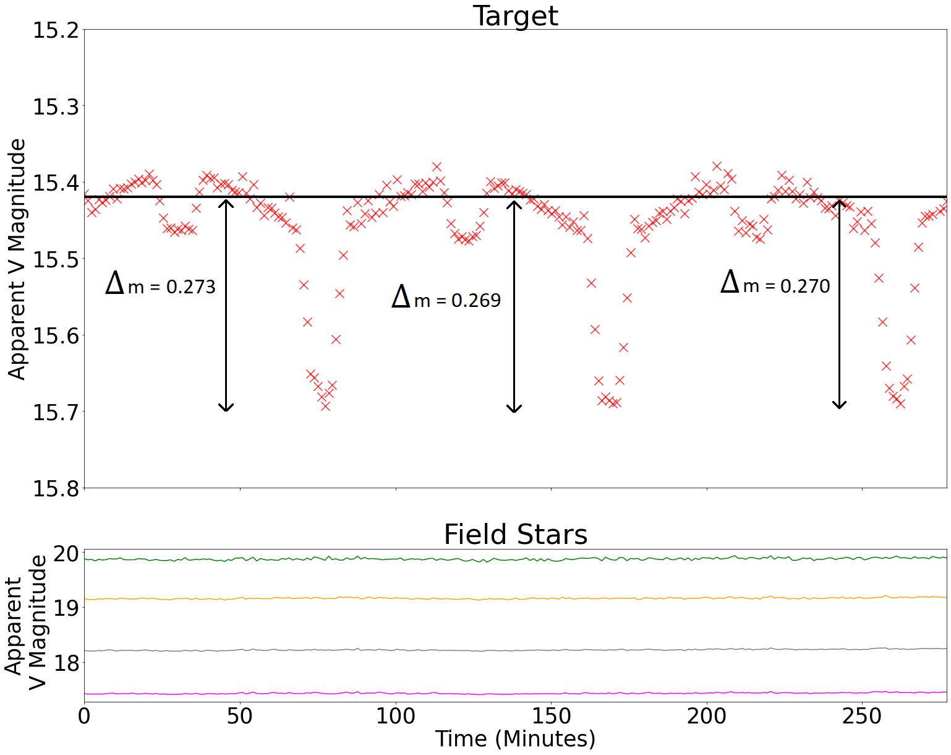

Slide 26
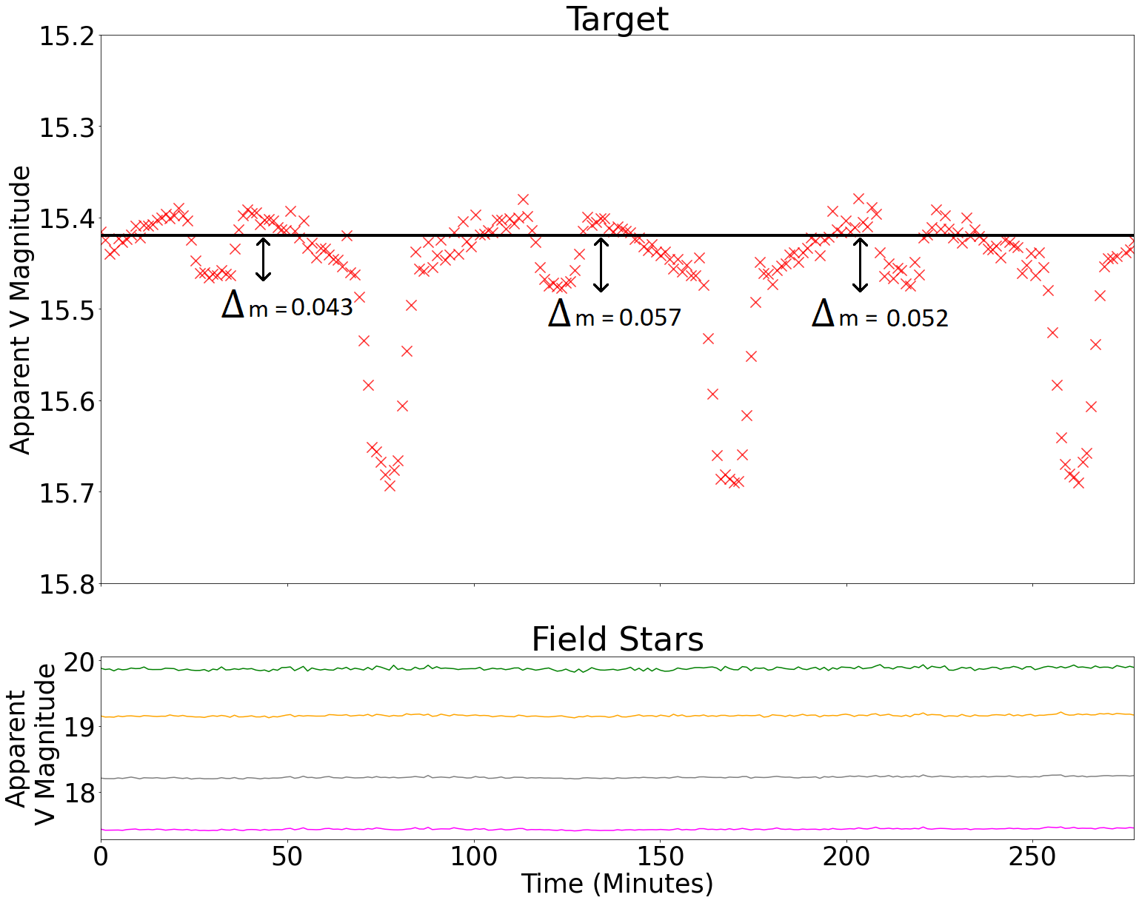

Slide 27
Measured Values
Period (Average) = 92.4235 minutes = ~ 1.5404 hours
Actual Period = ~1.541 hours
Error = ~ 0.04 %

Slide 28

Measured Values
Average V magnitude = ~15.42
Actual V Magnitude = ~15.82
Error = ~2.53 %

Slide 29
Measured Values
Primary Dip = ~ 0.271
Relative Primary Dip = 98.242 %
Secondary Dip = ~ 0.051
Relative Secondary Dip = 99.671 %

Slide 30
Measured Values
Primary Dip lasts for = ~ 18.478 minutes
Relative length of Primary dip w.r.t to period = ~ 0.19993
Secondary Dip lasts for = ~ 18.482 minutes
Relative length of Secondary dip w.r.t to period = ~ 0.19997

Slide 31
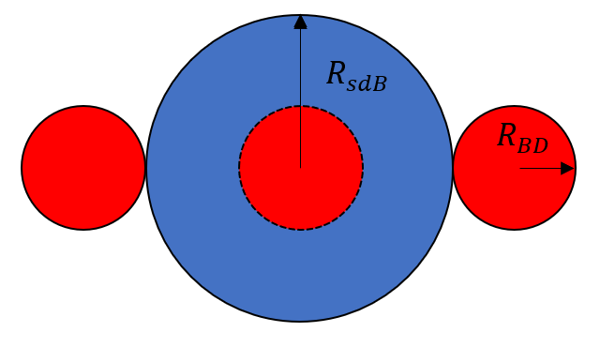
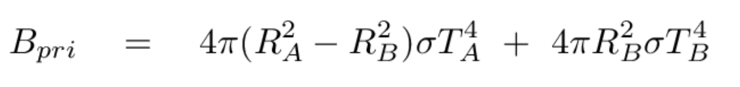
Primary Dip
Hotter star is hidden.
Stefan Boltzmann Law: σT^4 multiplied by area
Light received:

Slide 32
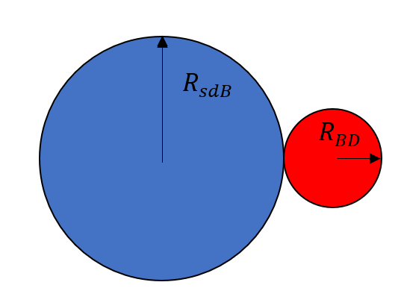
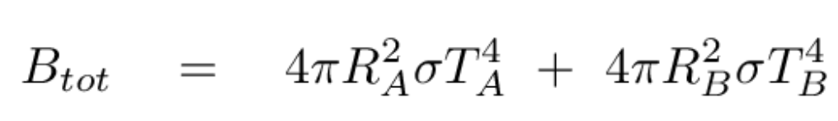
Total Light Received
Both Stars visible
Stefan Boltzmann Law: σT^4 multiplied by area
Light received:

Slide 33
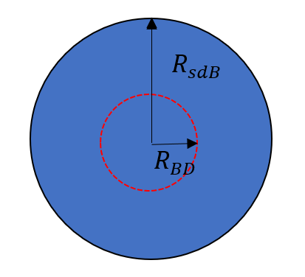
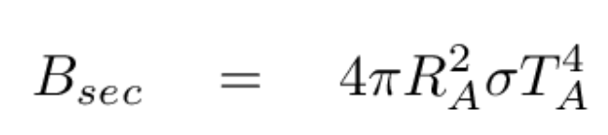
Secondary Dip
Cooler star is hidden.
Stefan Boltzmann Law: σT^4 multiplied by area
Light received:

Slide 34

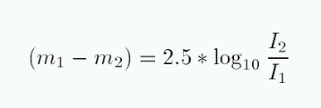
Converting magnitudes into Flux
Using Pogson's equation:
This Photo by Unknown author is licensed under CC BY-NC-ND.

Slide 35
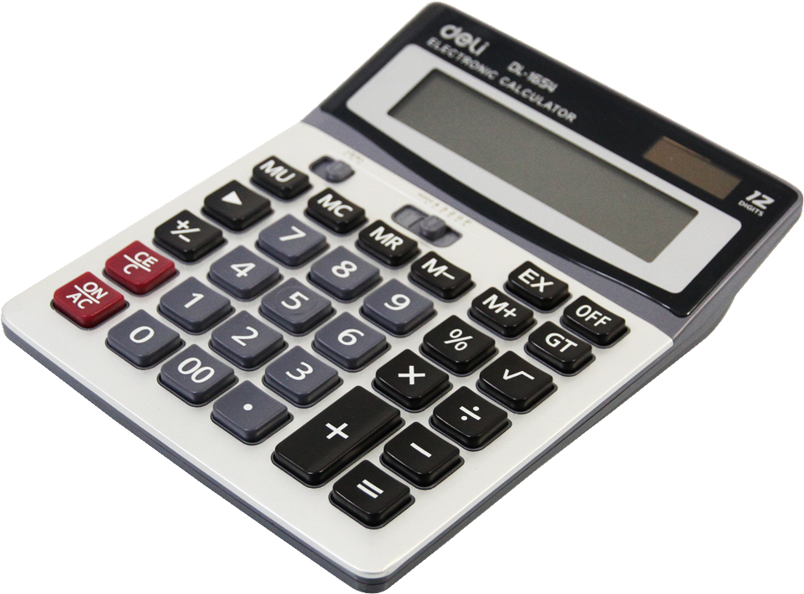
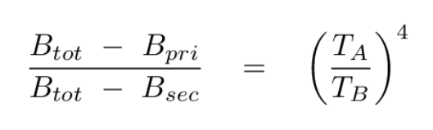
Calculations
So, if we take ratio of primary and secondary dips, we get:
~ 5.917

Slide 36

Calculations
Now, if we take ratio of primary light to secondary light, we get:
P / S = (1 - (R_B / R_A)^2) + (R_B / R_A)^2 * (T_B / T_A)^4
On substituting the values for LHS and (T_B / T_A)^4, we get:
0.817 = (1 - (R_B / R_A)^2) + (R_B / R_A)^2 * 0.1692

Slide 37
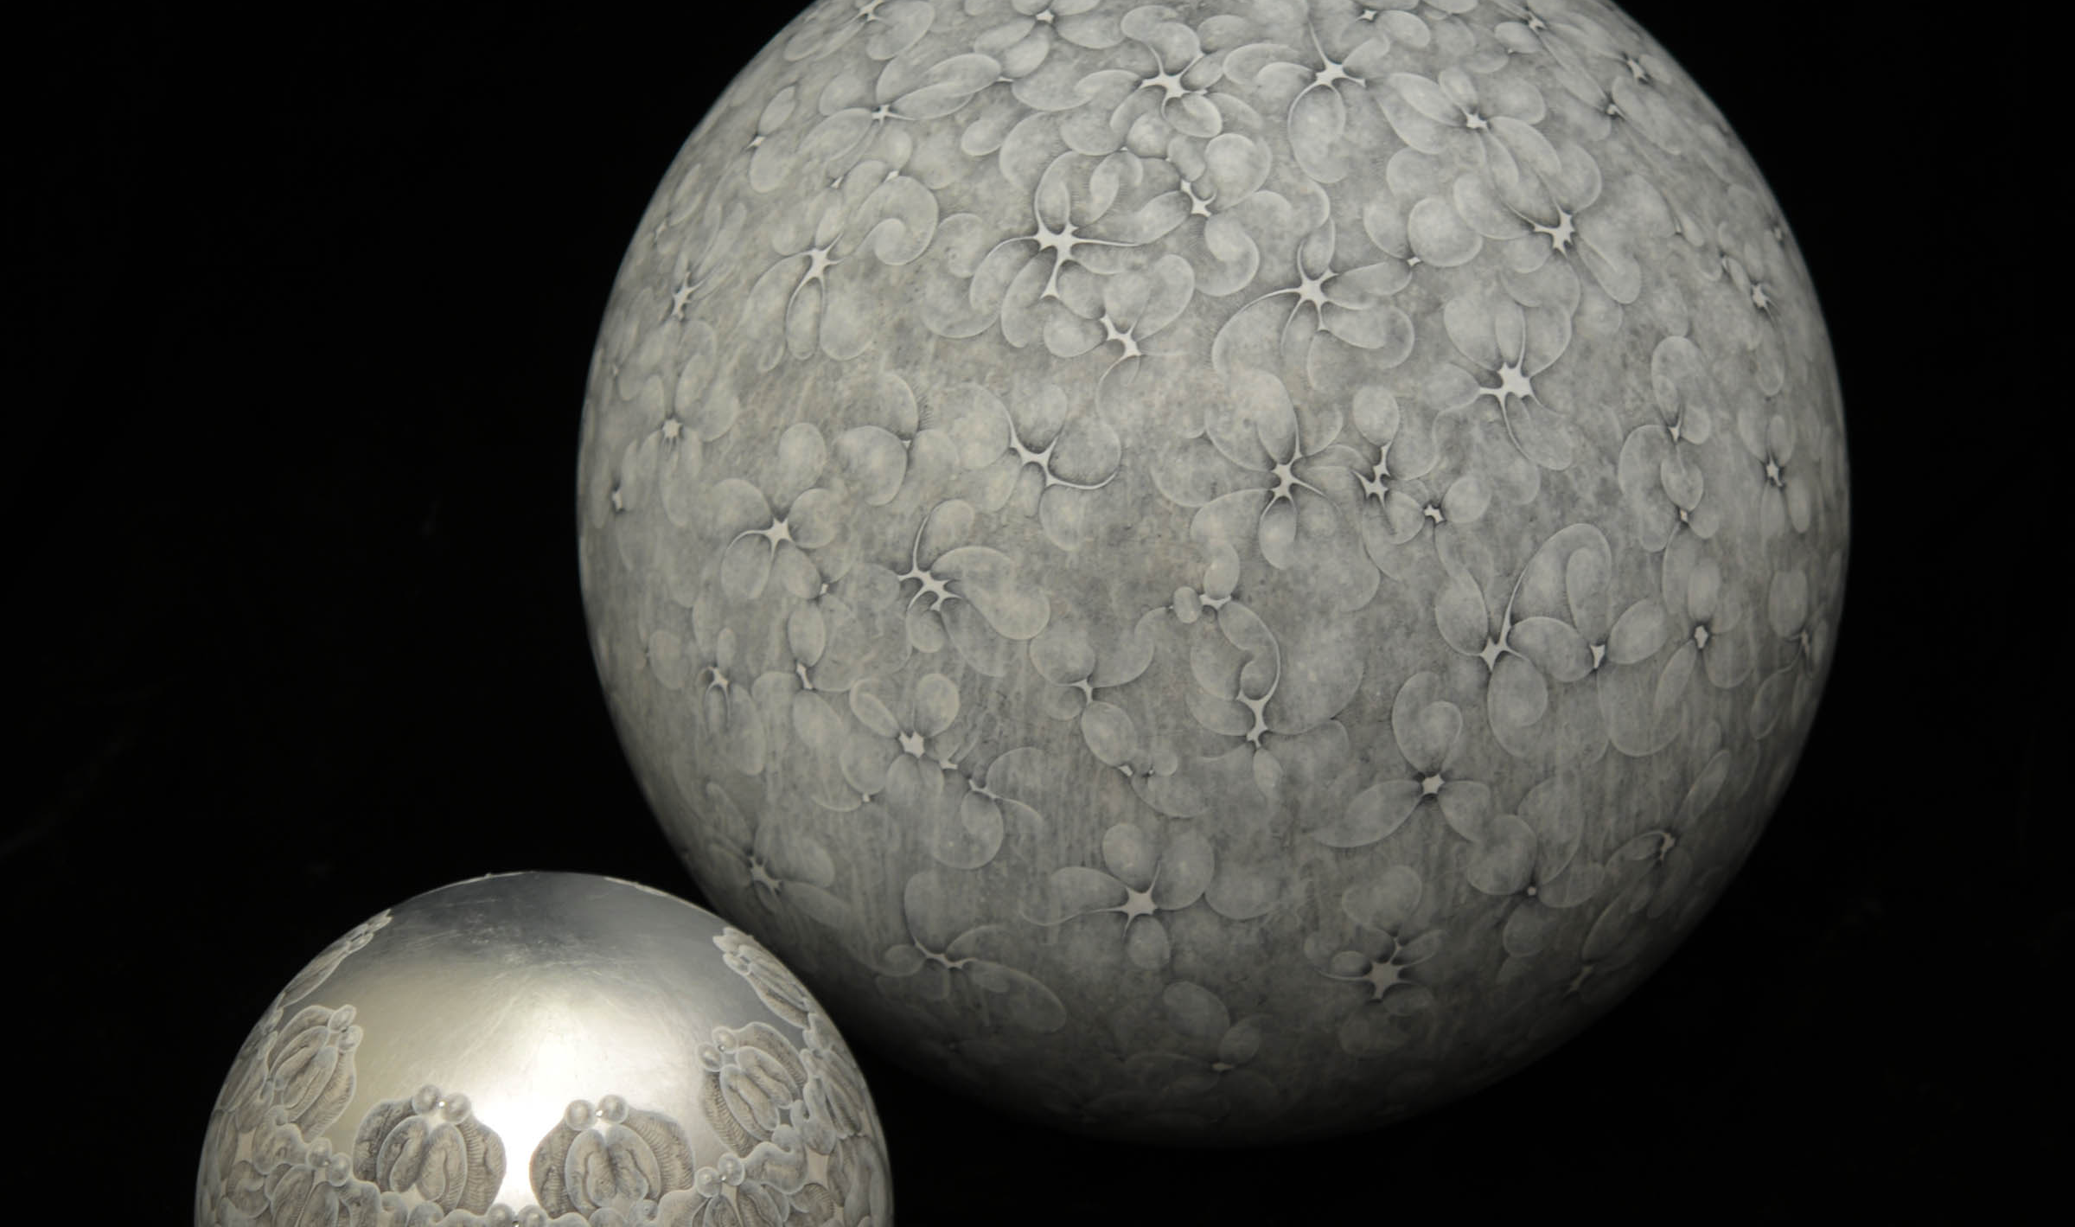
Calculations
On further simplifying it, we get that:
R_B / R_A = 0.220
This means, the brown dwarf (Star B) has a radius of 0.22 times the radius of the sub-dwarf B type star.
This Photo by Unknown author is licensed under CC BY-NC-ND.

Slide 38

Conclusion
A typical brown dwarf has an average radius of 1 R_J = 0.086 R_sun
On the other hand, the radius of typical sdB star is = ~0.25 R_sun
So, the ratio of BD to sdB is roughly = ~ 0.344
This is close to our value.

Slide 39
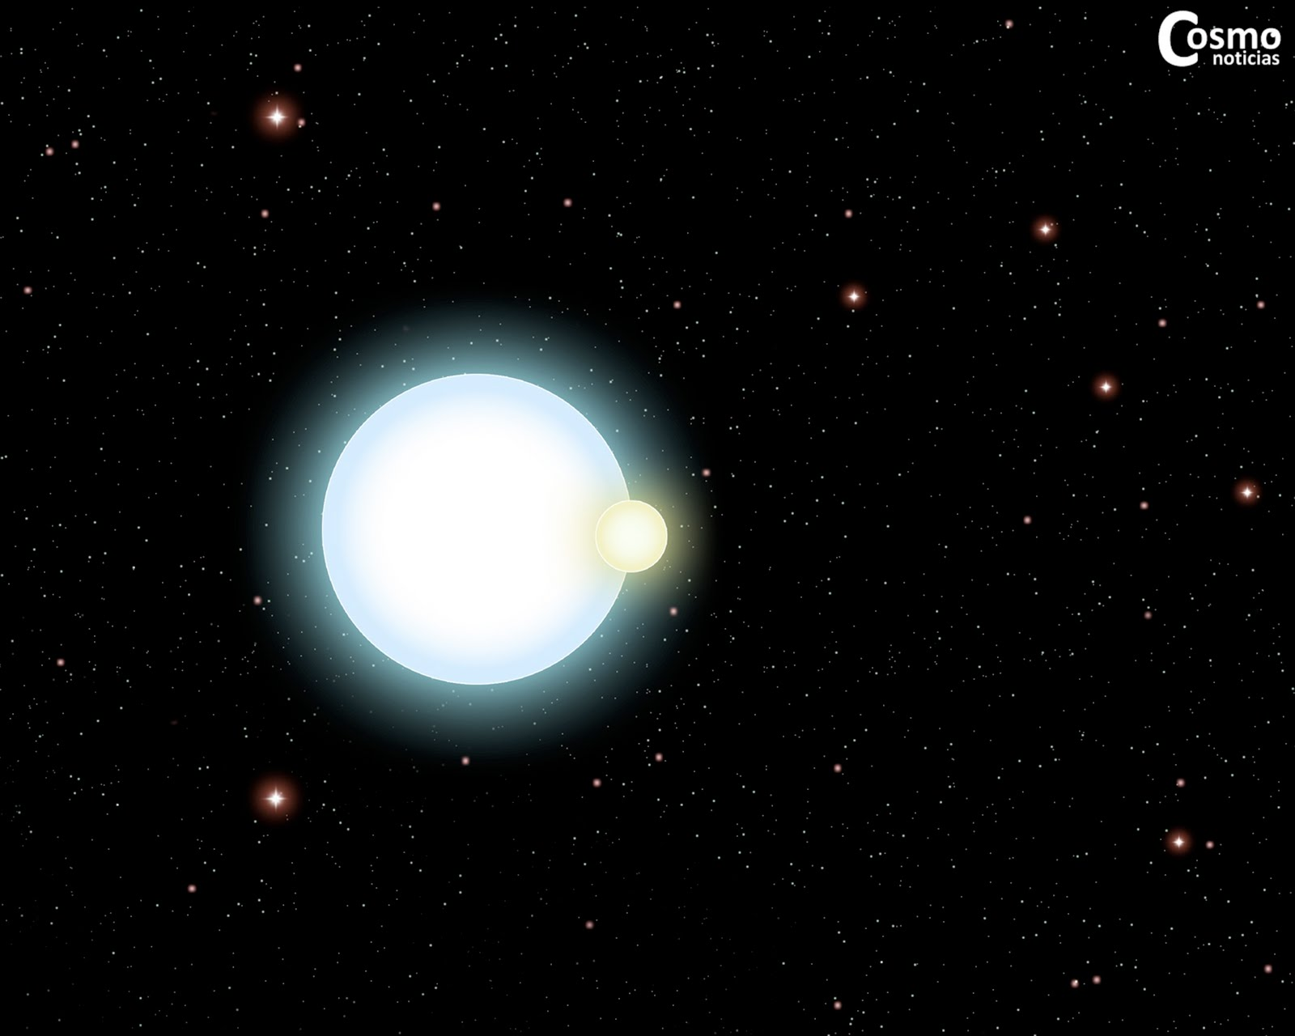
One more thing:
Now we can use the time of eclipses to calculate the distance between the stars:
Relative length of dip w.r.t to period = 2 * (R_sdB + R_BD) / (2 * π * a )
(where 'a' is the semi-major axis)
Substituting the values of R_sdB (taking it 0.2 R_sun) and R_BD from earlier
slides and also the LHS of this equation, we get:
0.1999 = 0.2 * 1.22 * R_sun / (π * a )
This Photo by Unknown author is licensed under CC BY-NC.

Slide 40
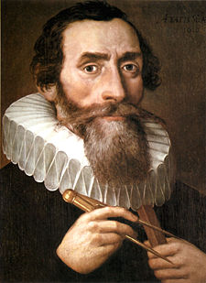
One more thing:
We get,
a = ~ 0.0018 au
One way to check this is by using Kepler's third law:
M_total = a^3 / P^2
Assuming M_sdB = 0.5 M_sun and M_BD = 0.075 M_sun, and using the period 1.542 hours = ~ 0.000176 years, we get:
a = ~ 0.0026 au
This Photo by Unknown author is licensed under CC BY.

Slide 41
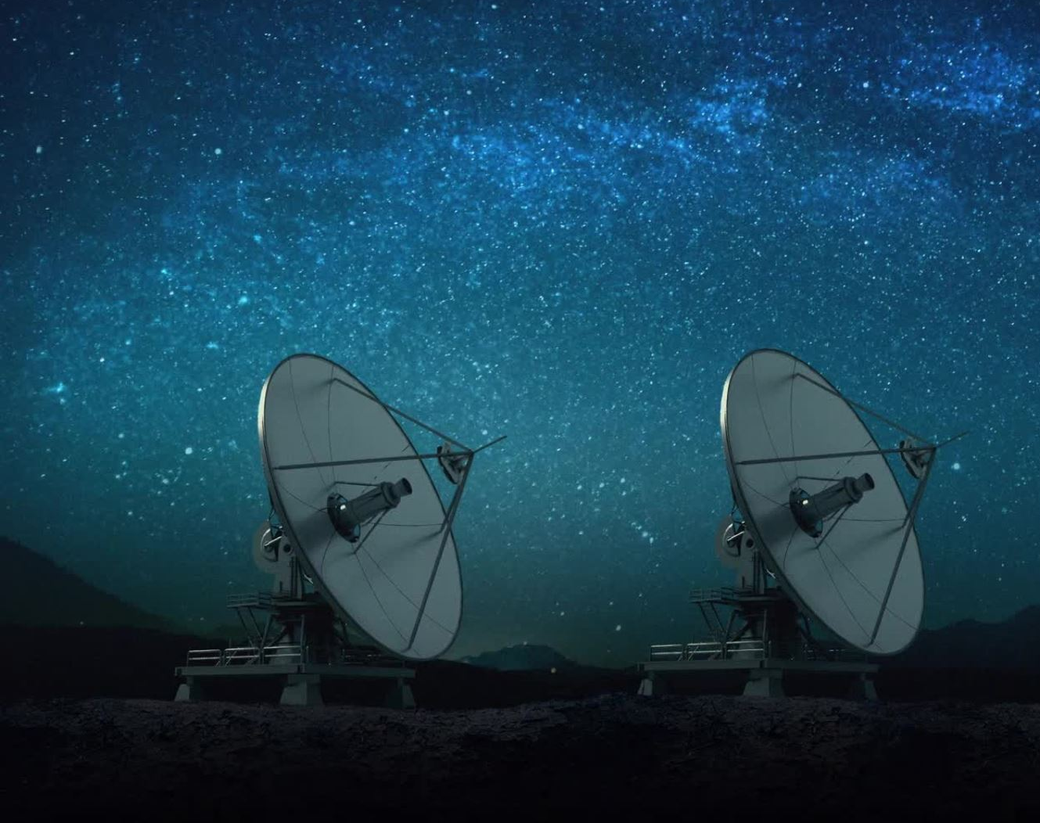
Why these stars?
Hot subdwarf plus close, cool companion
Post CE helps study the CE phase
Our instruments can detect these types of systems

Slide 42

The Eclipsing Reflection Effect Binaries from Optical Surveys (EREBOS)
Purpose:
Study the common envelope phases from the OGLE survey
The goal:
Finding the low-mass companions
Deriving the mass distribution
Constrain the fraction of substellar companions
Minimum mass needed to strip off a red giant envelope

Slide 43
The Eclipsing Reflection Effect Binaries from Optical Surveys (EREBOS)
Questions to be answered:
What is happening during the CE phase?
Is there a Lower/upper limit to the mass of a cold companion?
Sub-stellar verse brown dwarf/Jupiter like companions?

Slide 44

What's next for our data?
We still need two light curves for each UBVR filters.
Dr. Green will correct all the light curves in each individual filter for differential reddening at different airmasses over the course of each light curve observation (beyond the scope of this course).
The data will be sent to the EREBOS coordinators.

Slide 45


